Slide 1
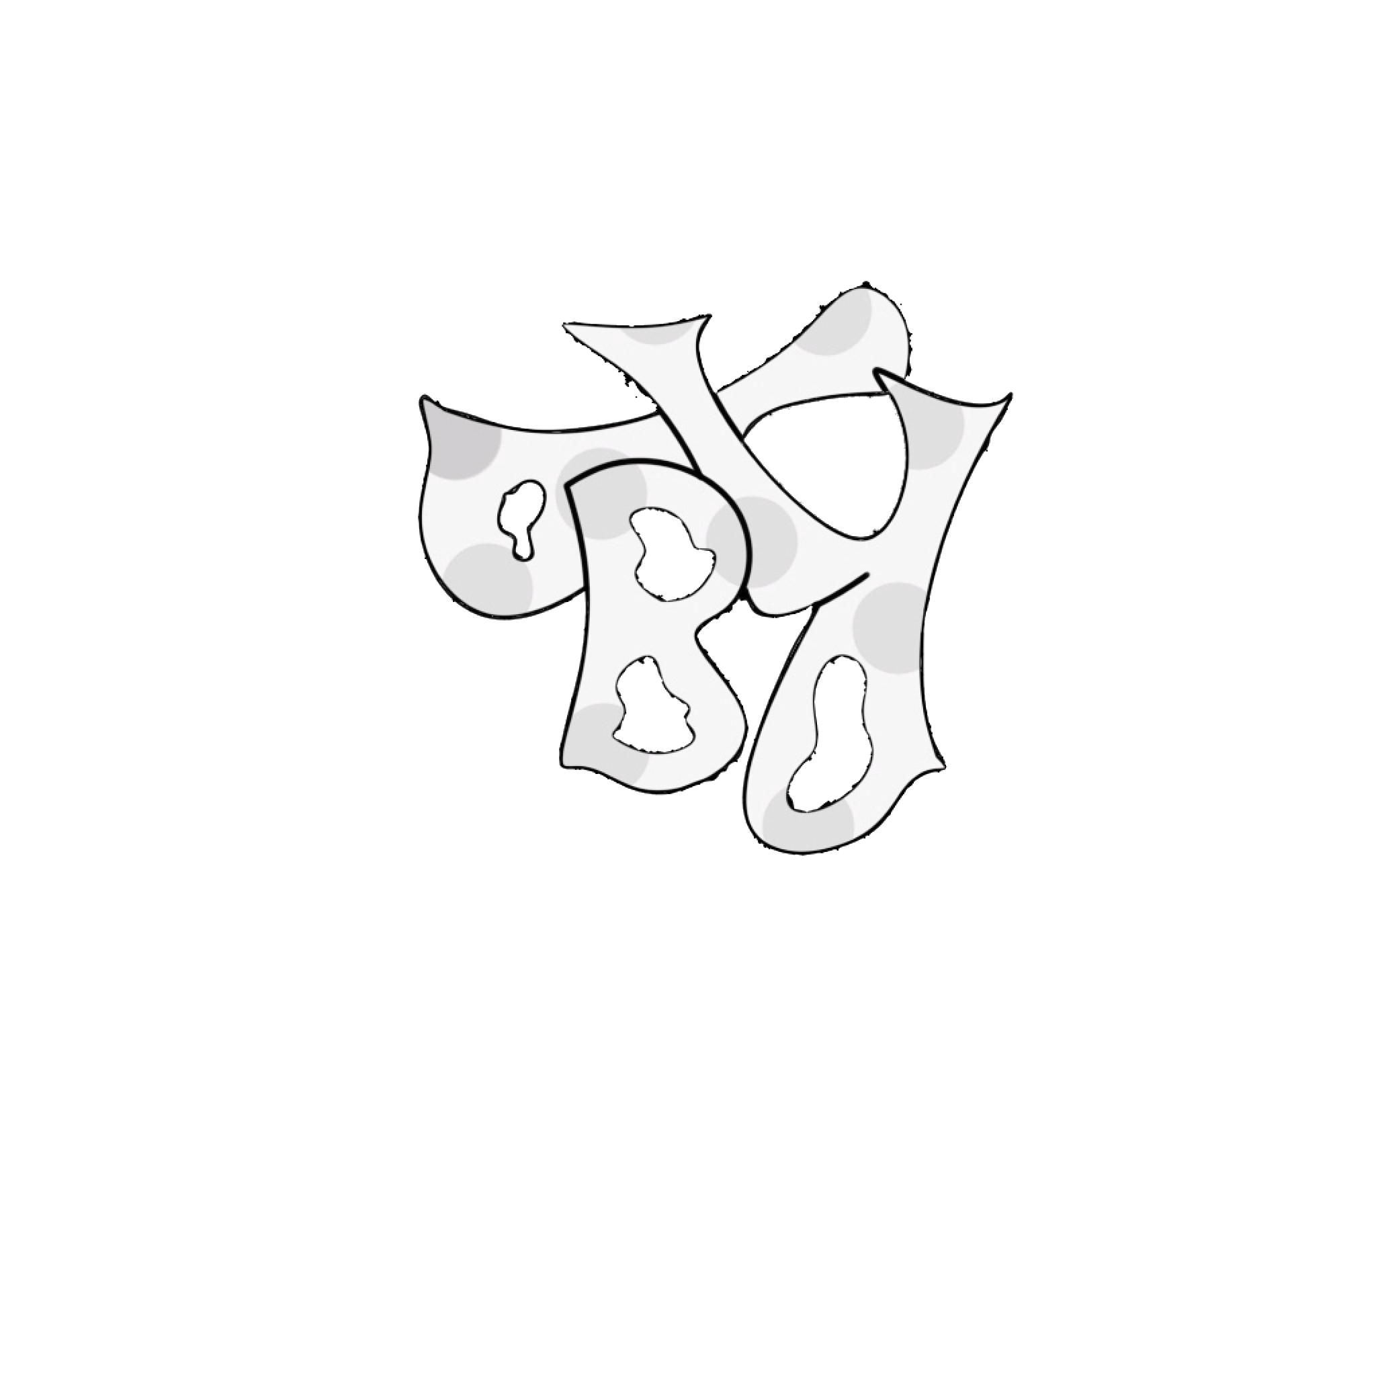
RAPHAEL BILLE FOMENA
BPR design &
everest inc
Front-end and Graphic designer

Slide 2
About me
My goal is to design, pixels to pixels my tomorrow using as main tool my creativity together with some other useful equipments used to facilitate and enhance passion in design.
Furthermore, i aim at solving as many problems as possible with my pencil.
Born in cameroon, i grew in the territory and later on travelled to belgium for studies.

Slide 3
Qualifications et competences
3D design
Flyer, logo,posters,2D design etc
Computer maintenance
HTML, CSS,SASS,JS, BOOTSTRAP

Slide 4

Some projects

Slide 5


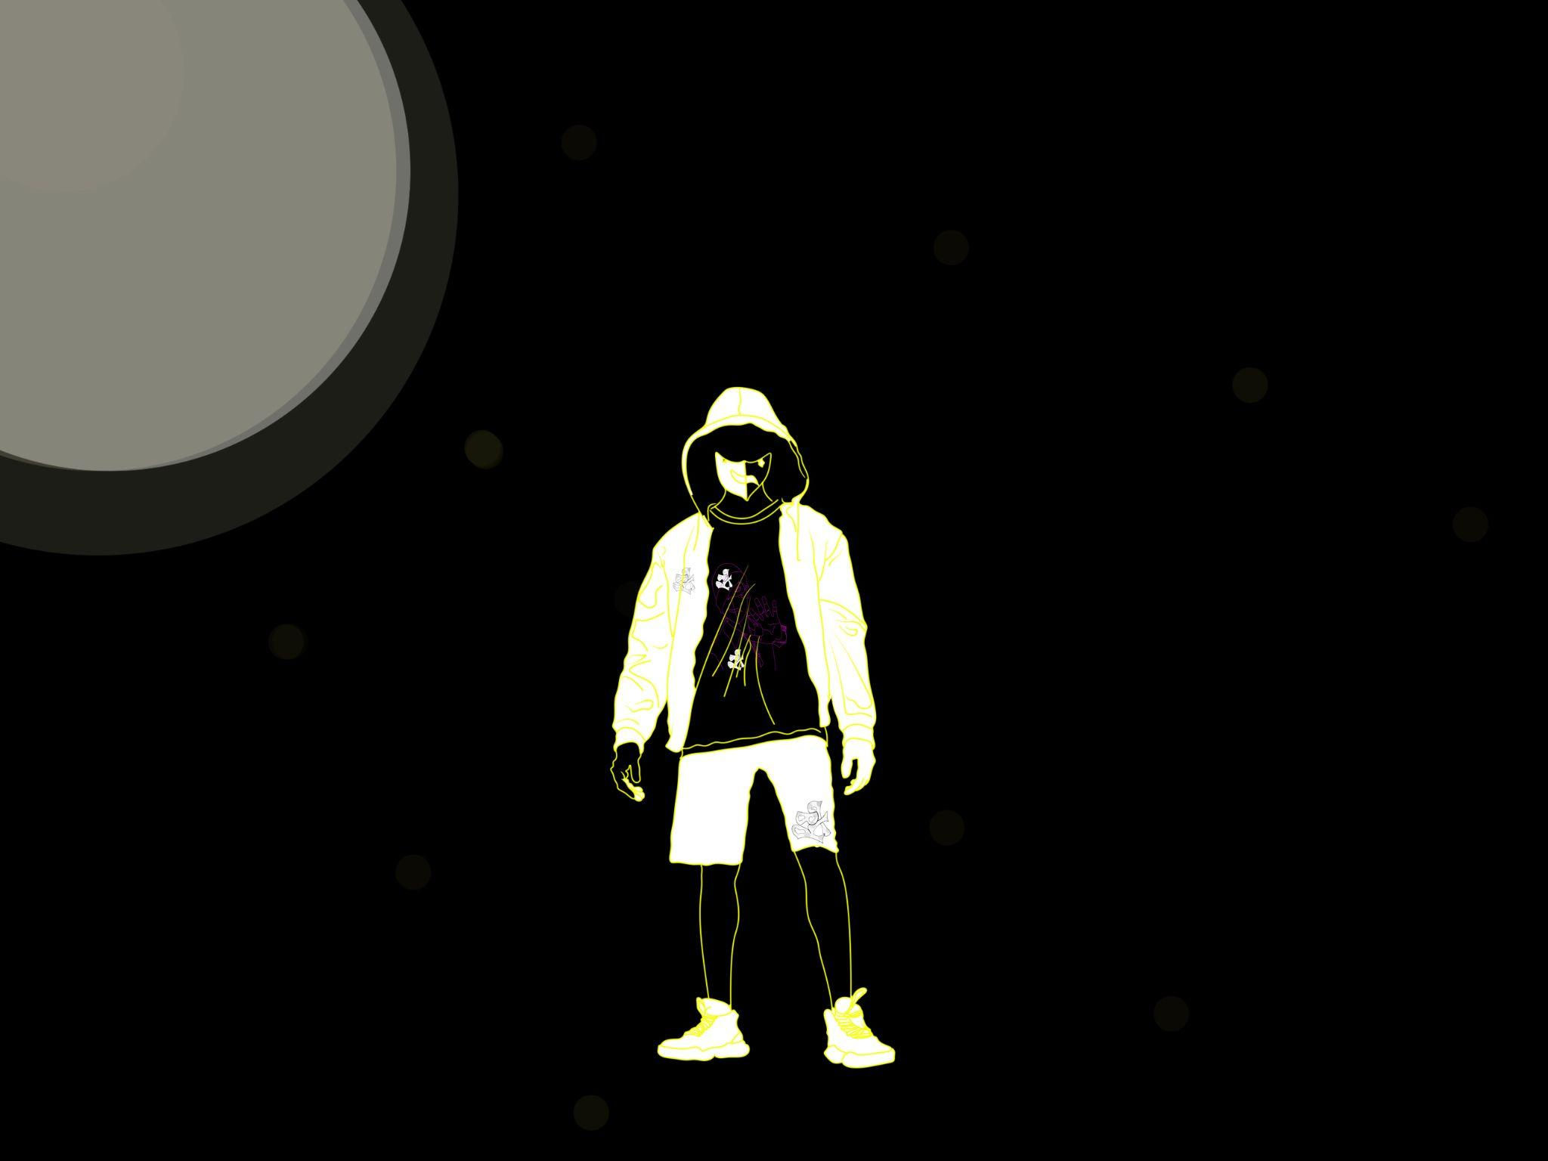
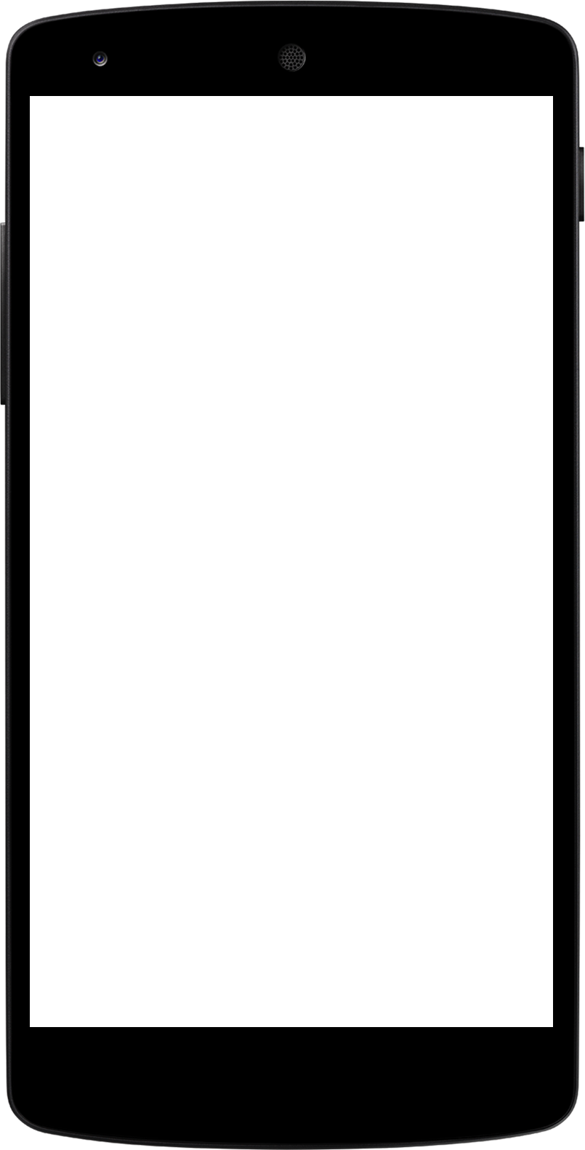
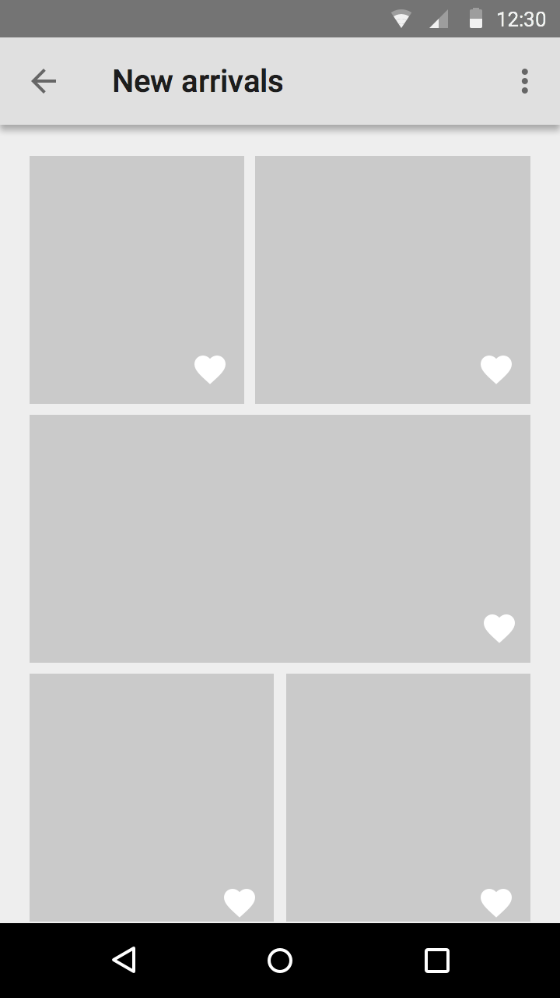
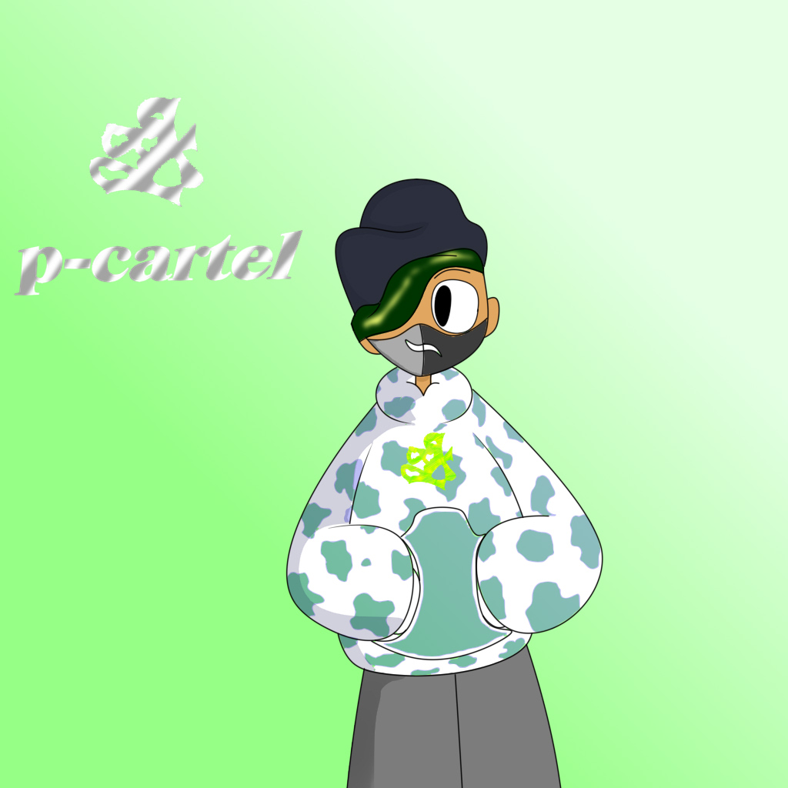
black mood mural art
others include;
BPR flyer type
BPR business type card poster type

Slide 6
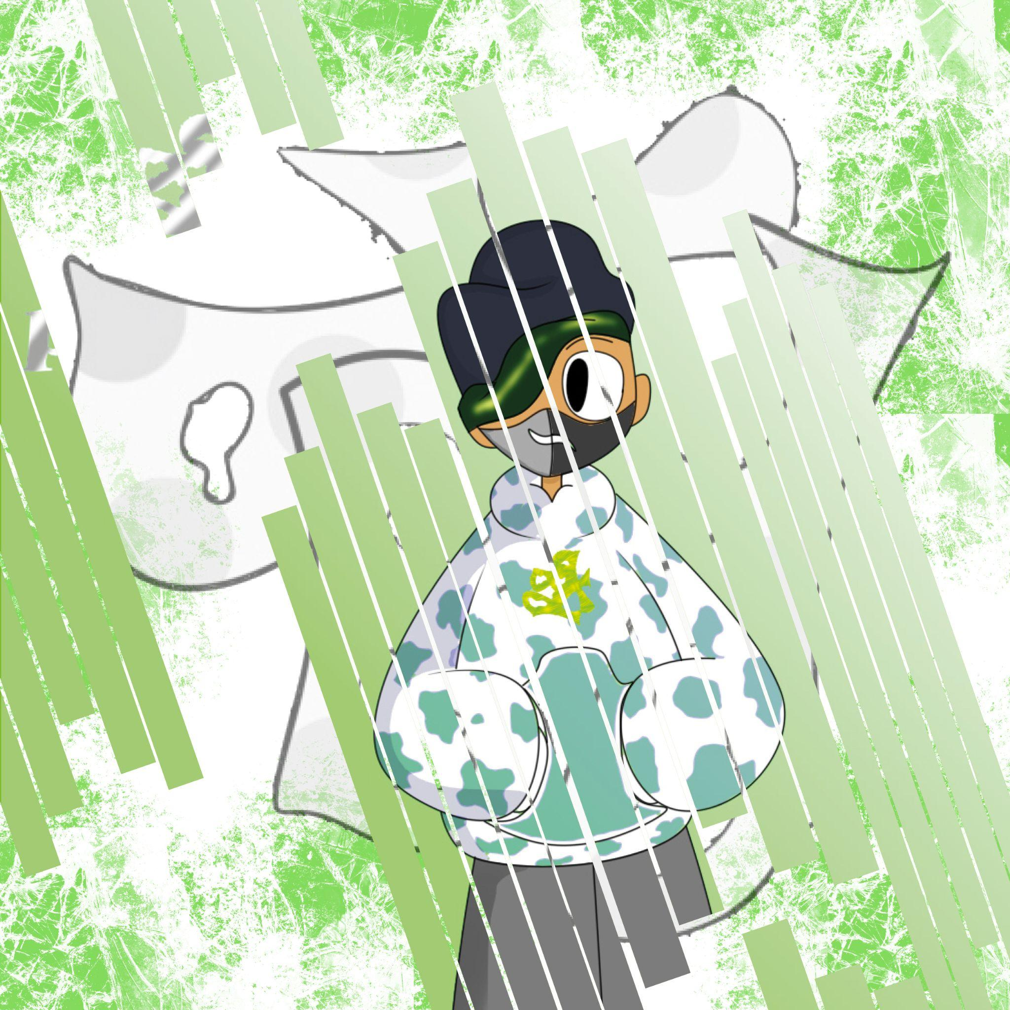


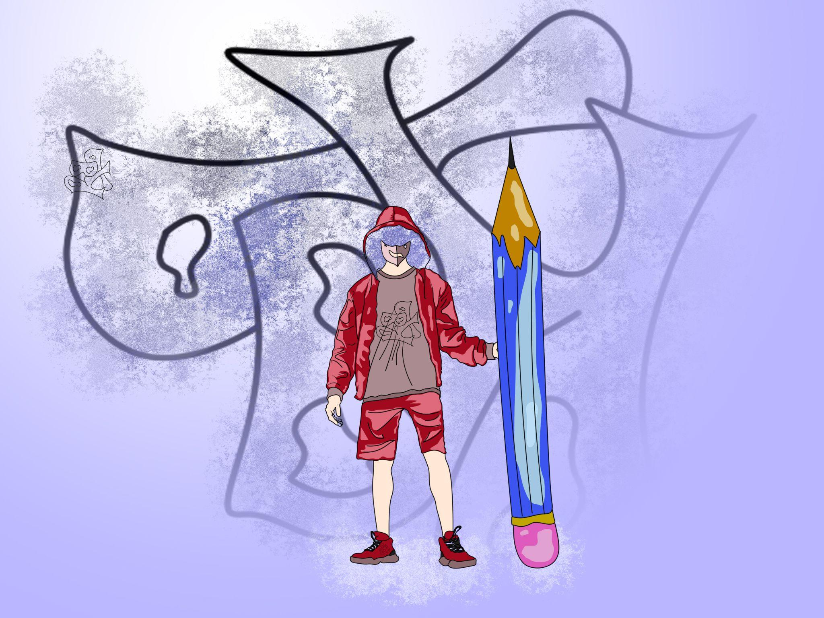
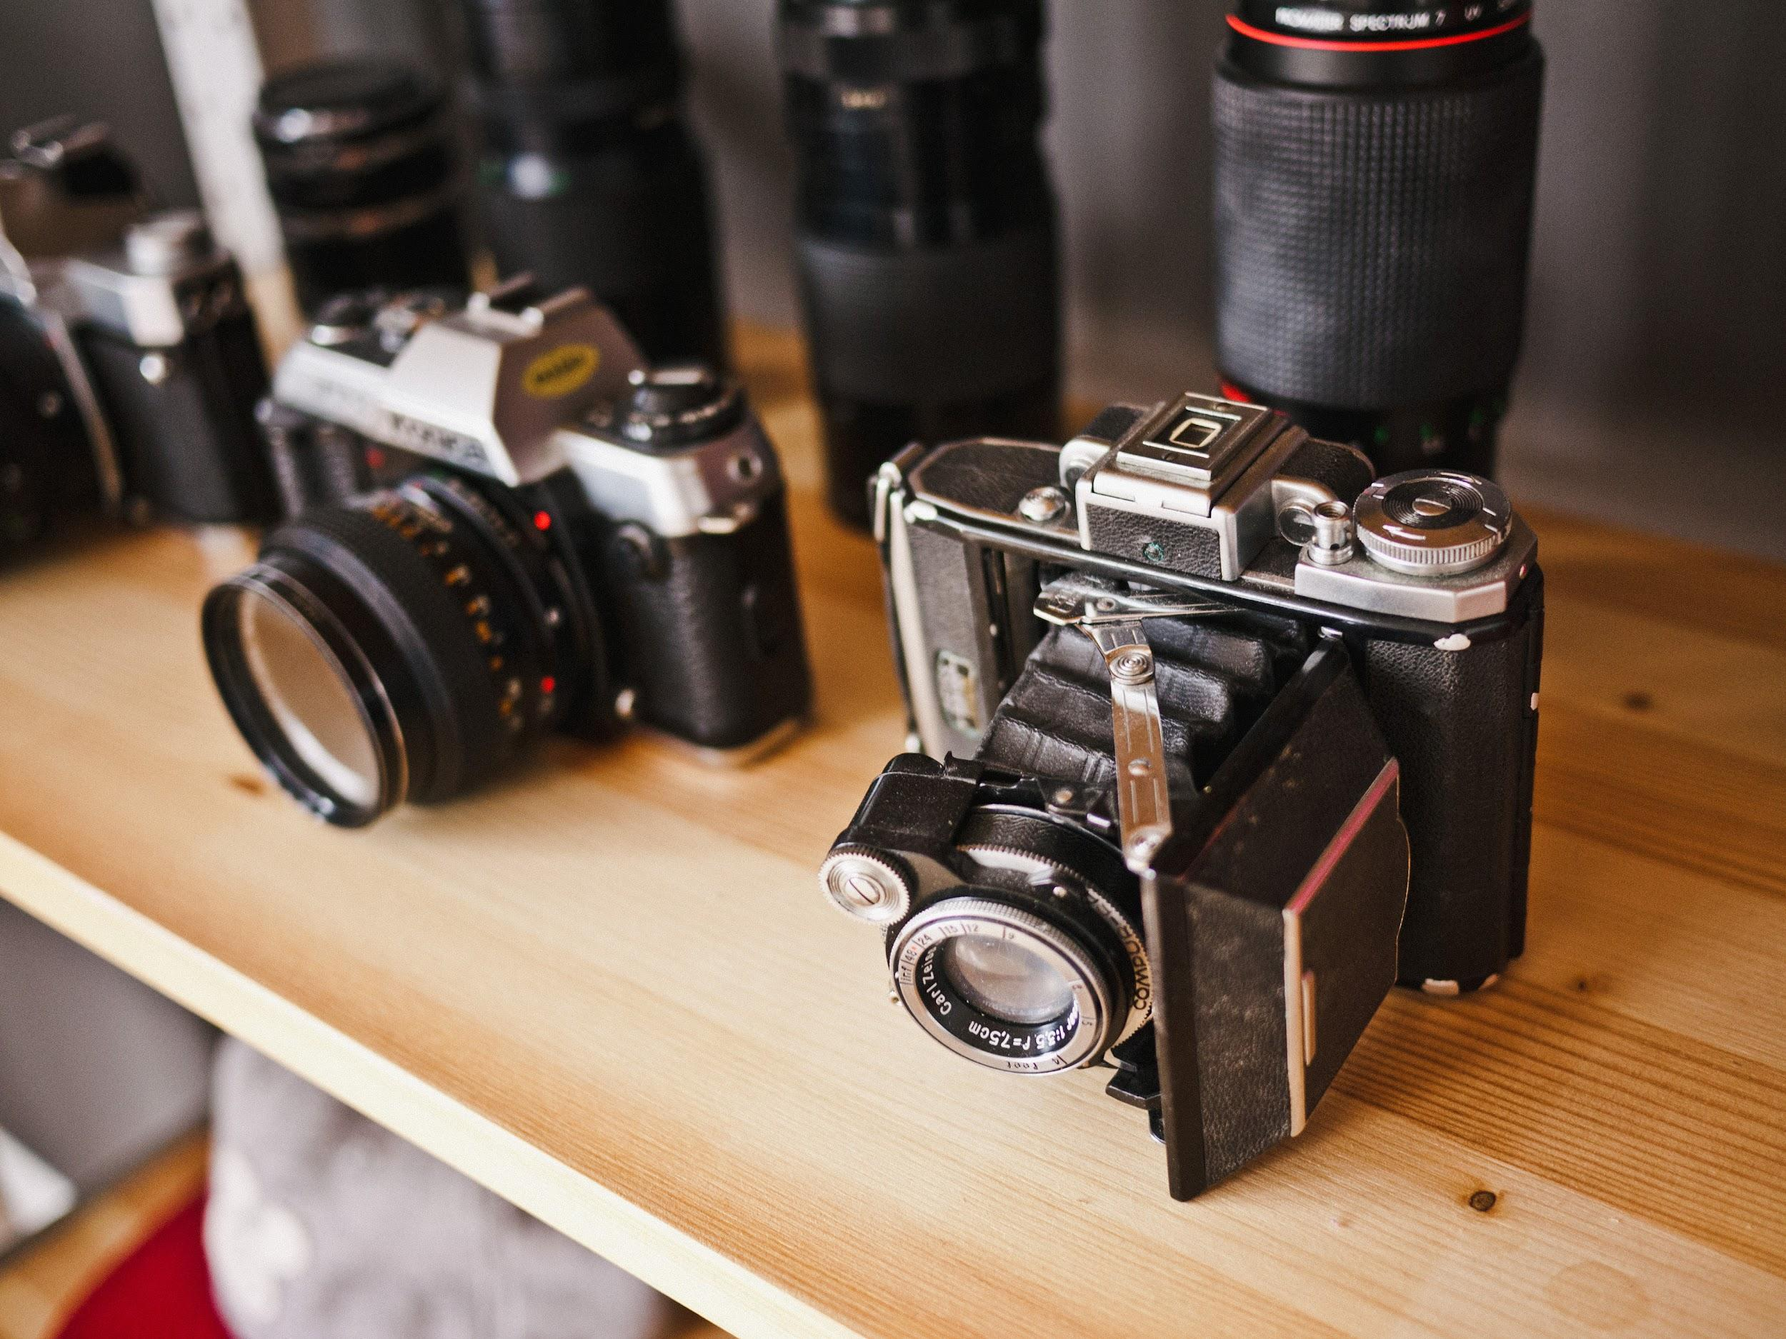


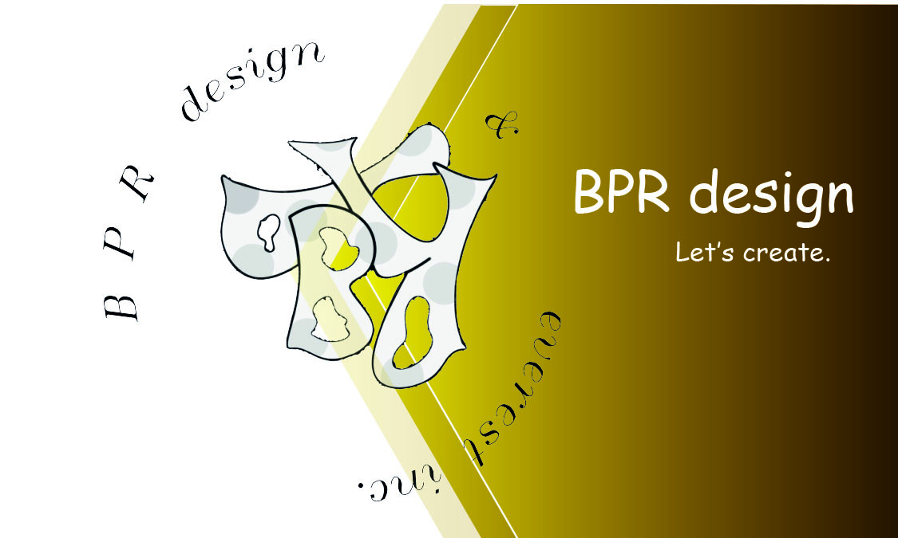
Cards
Flyers,posts,banner,etc
Simple cards of all types including postal cards, business cards… just to name a few
Let’s draw. Representing information is always better with some addictive design

Slide 7
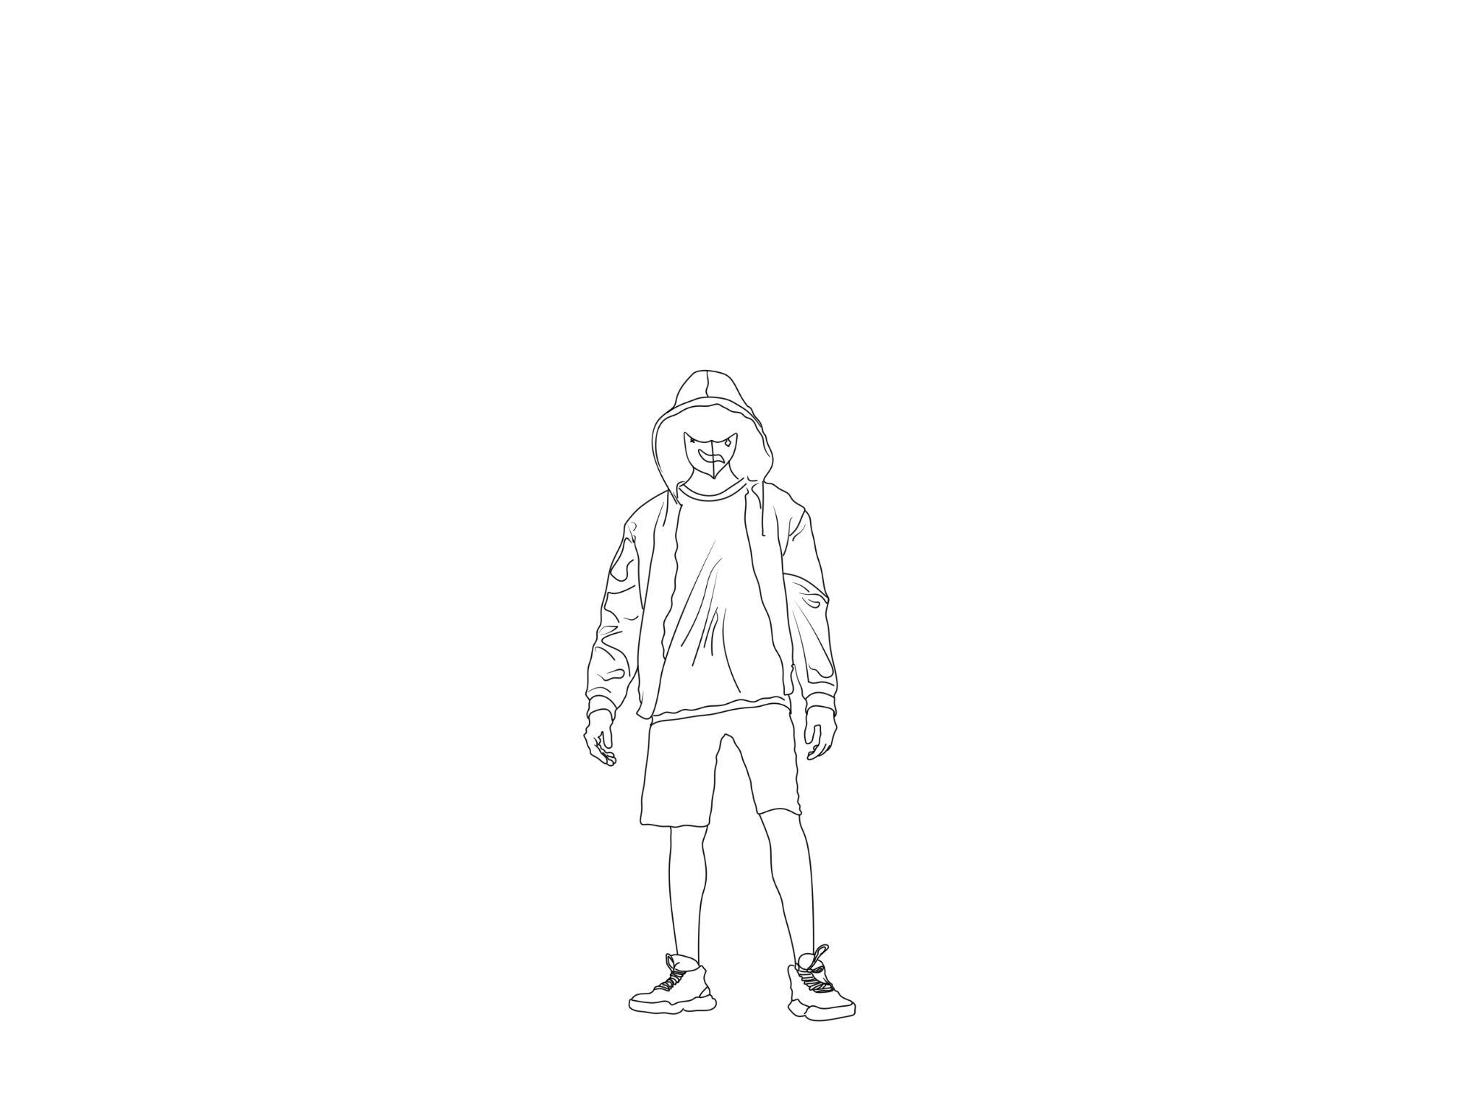

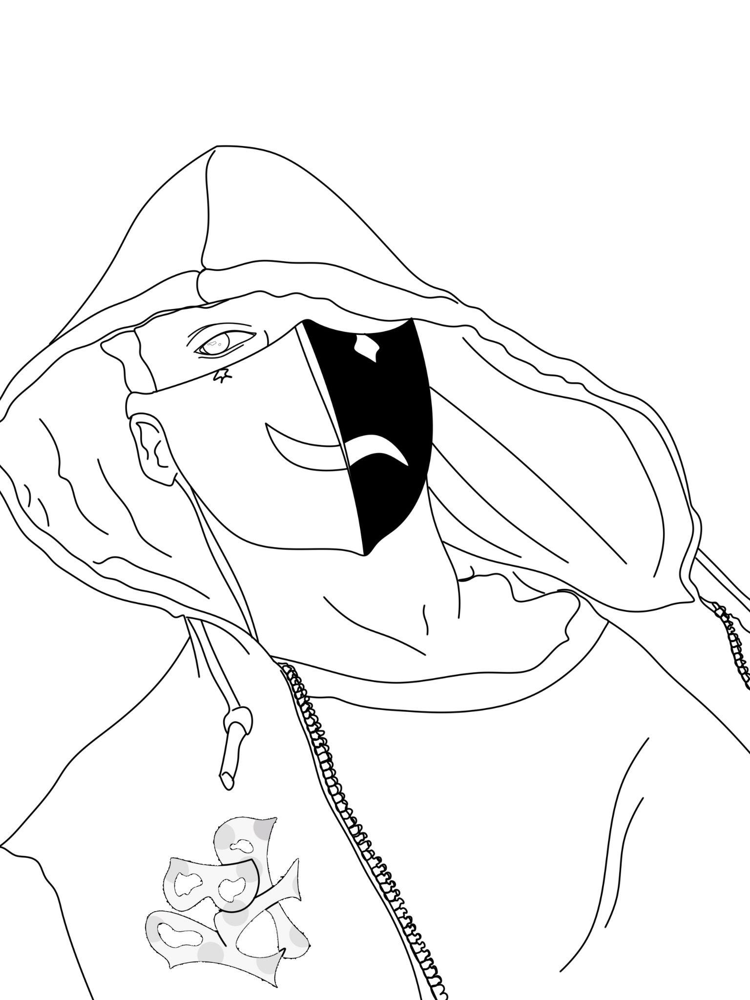
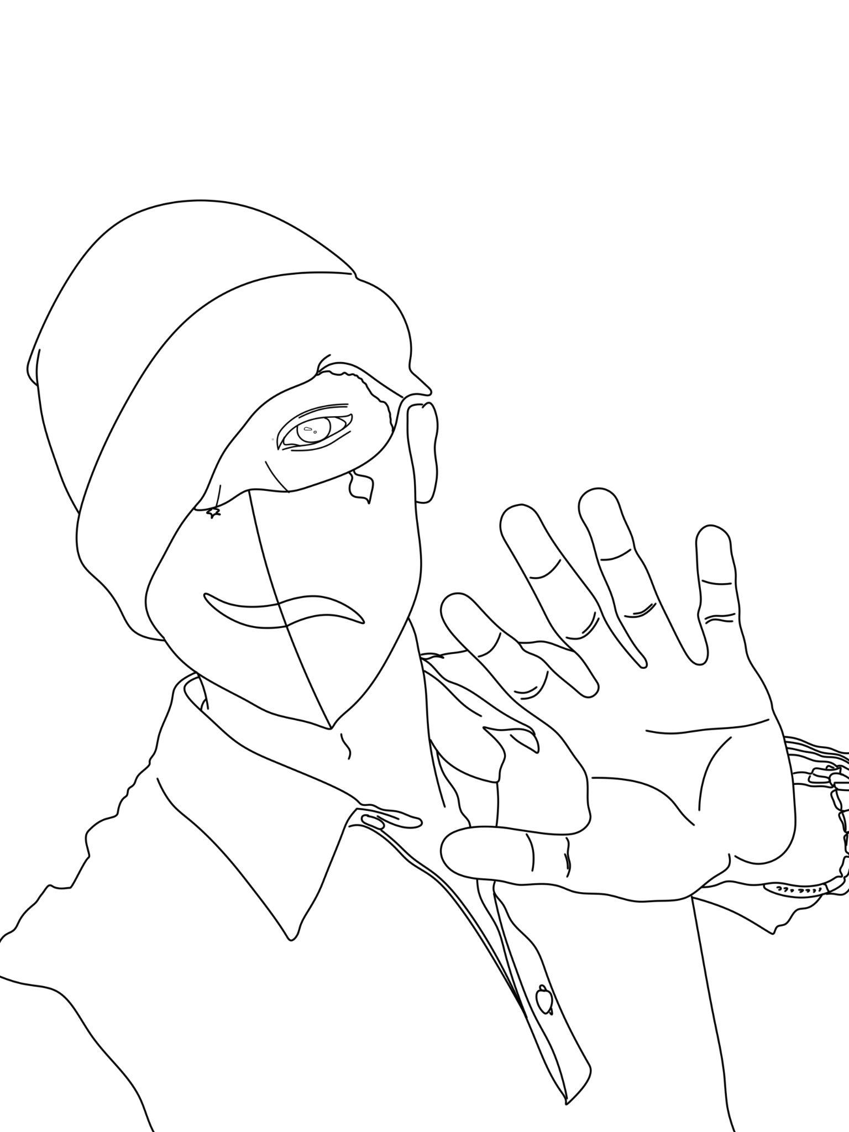
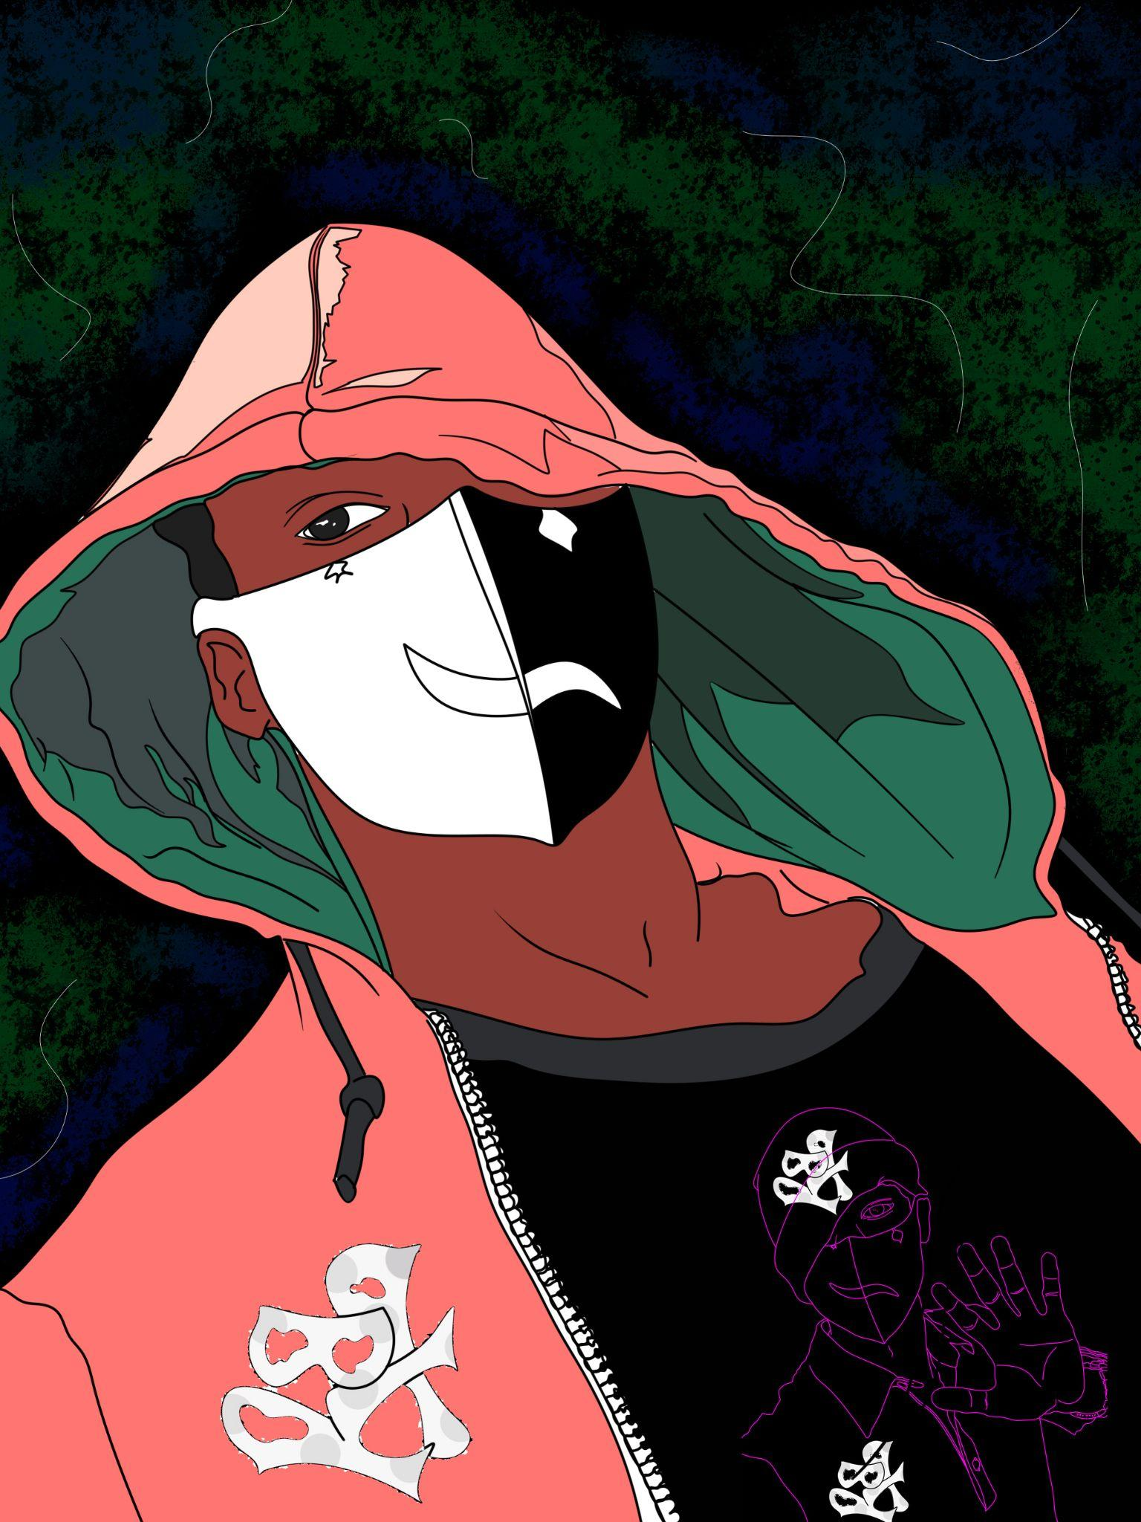


Slide 8
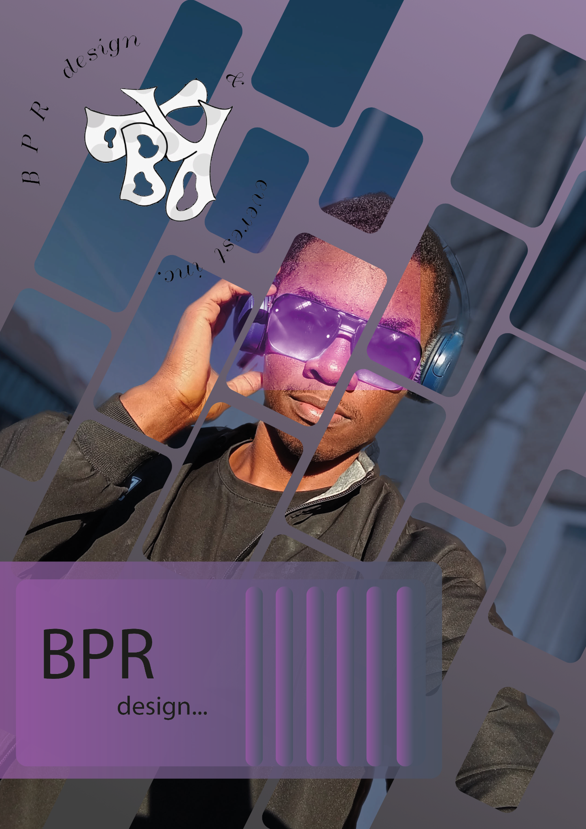
Contact
Raphael. Bille Fomena
rapfom@gmail.com
+32 470 18 11 69
+237 651 500 099

